Slide 1
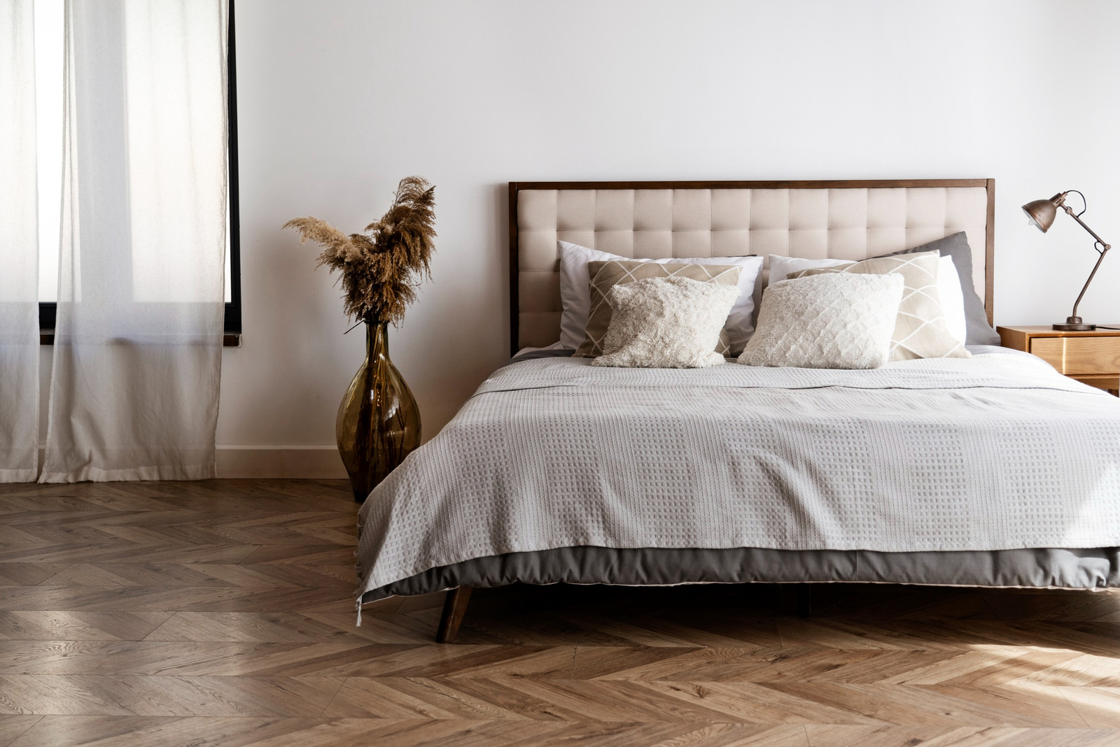

Login
sign up
About
Muغtareb
Start your housing journey today
Discover your perfect future on our website, where expatriate students find ideal rental accommodations.

Slide 2



Name
Age
Level
National ID
Collage
Gender

Slide 3
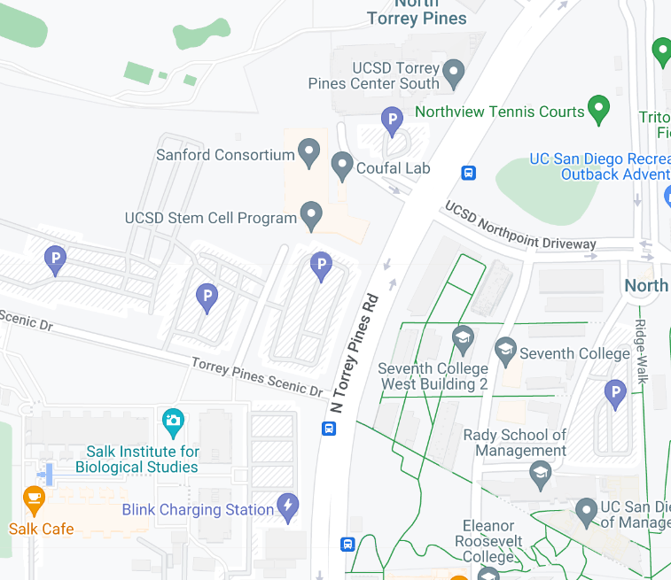



Filters
Location
price
Interior possibilities
Number of Room
Area
search

Slide 4
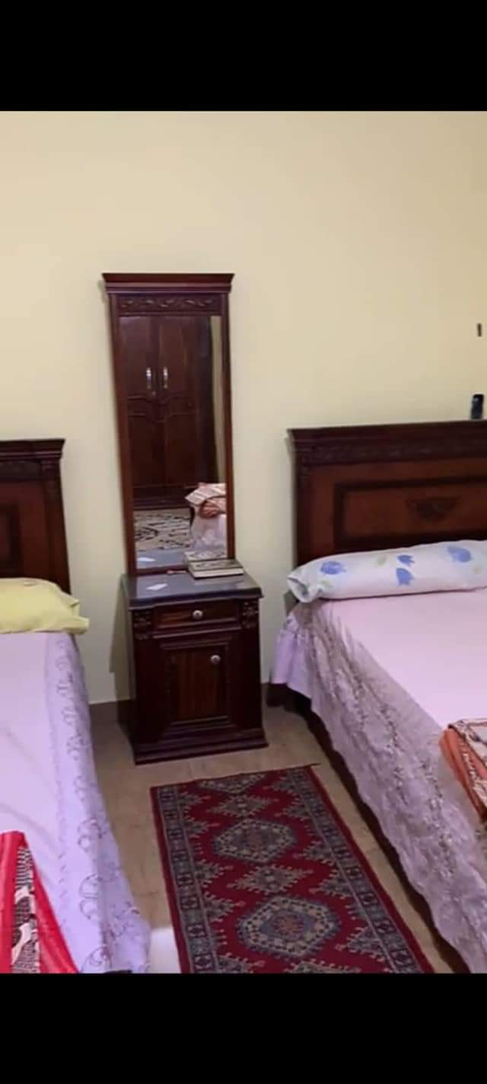
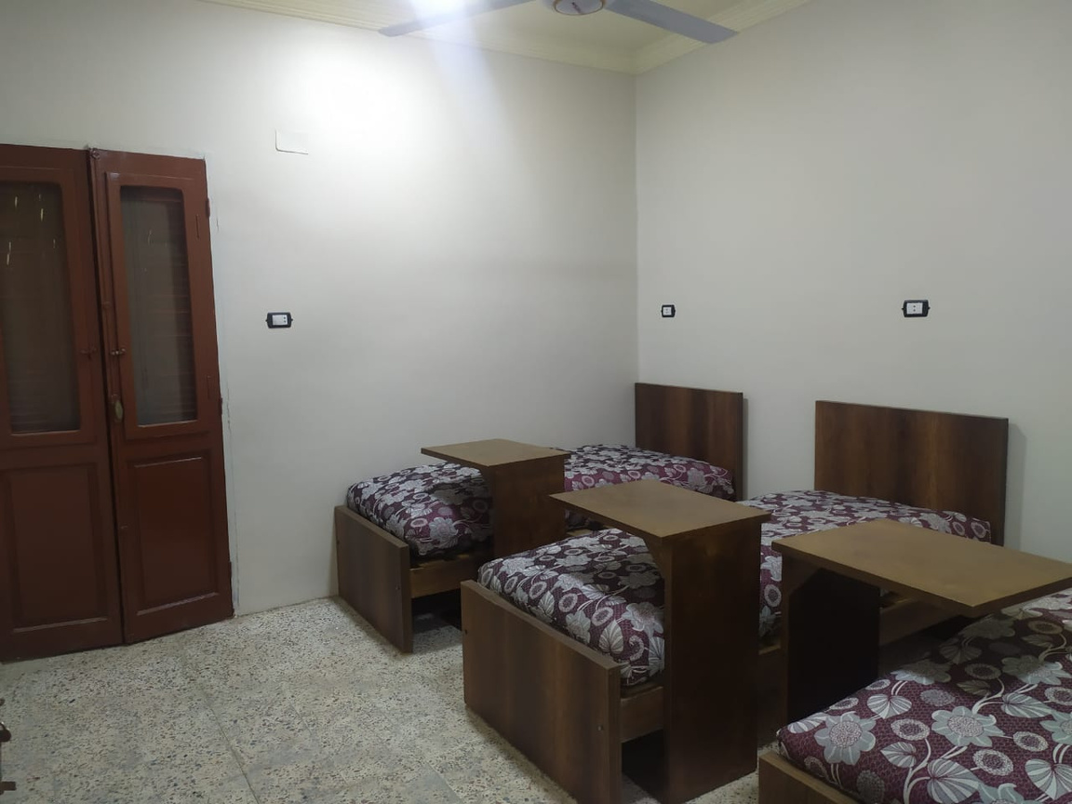
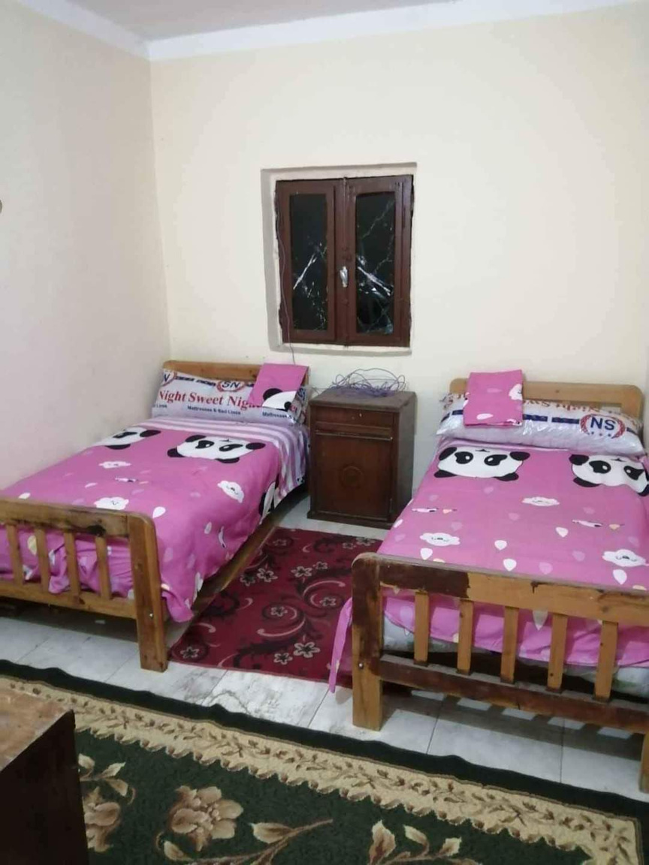
Price:
700 EGP
Price:
700 EGP
Price:
500EGP
locatio:
Alexandria
locatio:
Asyut
locatio:
Ismailia
Advantages:
Advantages:
Advantages:
Internet....etc
Refrigerator.etc
Heater....etc
Explore
Explore
Explore

Slide 5




BOOK NOW
700EGP
MONTHLY
WIFI: YES
WASHING MACHINE: YES
REFRIGERATOR: YES
NUMBER OF TENANTS : 2
BALCONY: NO
LOCATION :116 SINAI STREET, NEXT TO KOSHARY EL TAYEB
NUMBER: 01015207024

Slide 6
BOOK NOW
700EGP
MONTHLY
WIFI: YES
WASHING MACHINE: YES
REFRIGERATOR: YES
ROOM TYPE : BED SPACE
NUMBER OF TENANTS : 7
LOCATION :ASYUT
NUMBER: 01015207024

Slide 7
BOOK NOW
500EGP
MONTHLY
AIR CONDITIONER: YES
NUMBER OF TENANTS : 4
WASHING MACHINE: YES
REFRIGERATOR: YES
NUMBER: 01015207024
LOCATION :23 EL DAKAHLIA STREET, IN FRONT OF EL SAFF TOWER

Slide 8
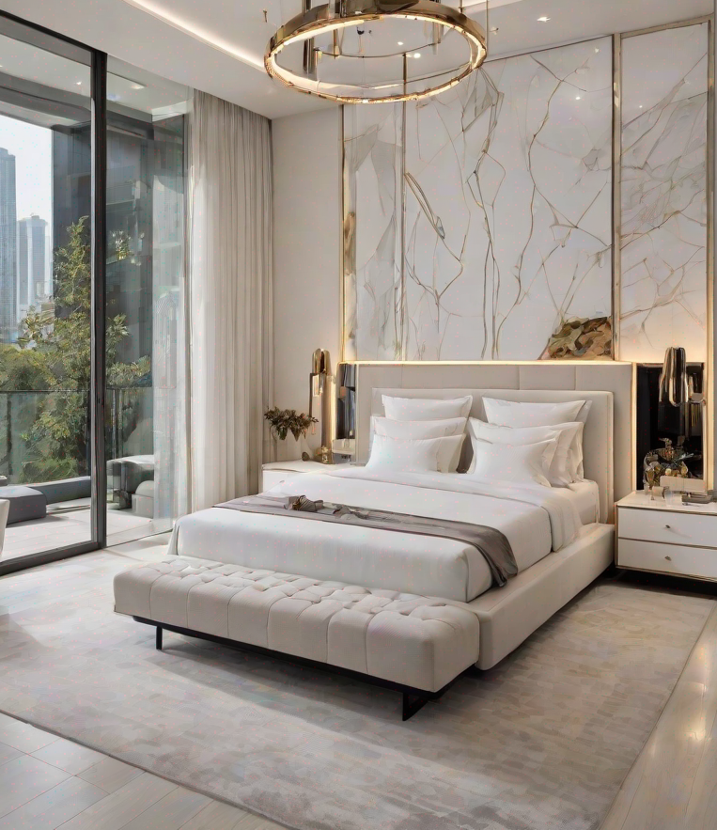
LOG IN
Email
password

